Slide 1
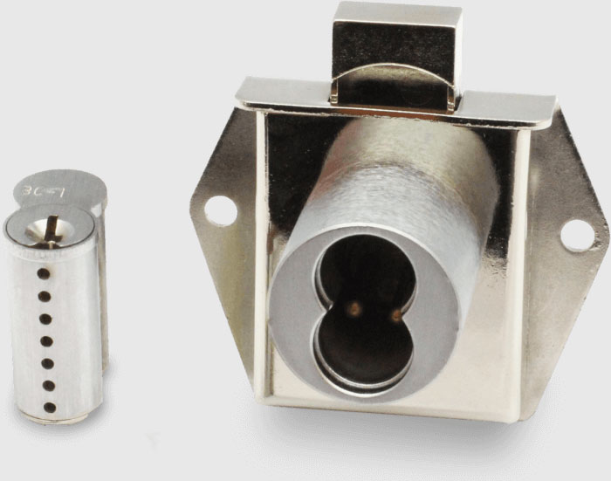
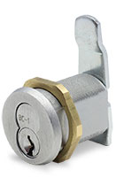
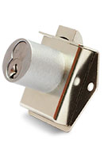
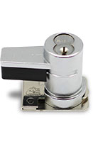
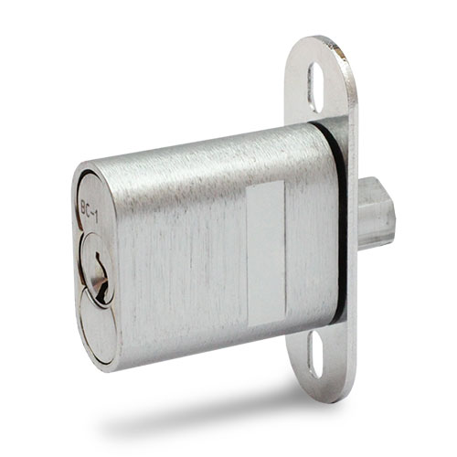
SELECTING THE CORRECT LOCK
??
A Buyer’s Guide To Proper Lock Selection

Slide 2
CRITERIA FOR LOCK SELECTION
In order to help determine what type lock should be purchased, here are a few of the many basic questions that need to be answered.
1. What is the application? Door, Drawer, Cabinet, Showcase, Glass Case, Locker, etc.
2. What is being protected? Nature of the asset or item being secured.
3. Level of security required? Low,, Medium or High.
4. Is the lock used with other security components on the fixture or display? Alarm systems, CCTV.
5. What is the construction of the fixture or component that requires the lock? Design or Engineering Drawing available.
6. What material will be accepting the lock? Wood, Metal. Solid Surface, Plastic, Glass, Composite or other.
7. Mechanical or Electronic lock preferred? Basic lock security or security data information required.
8. Cost factor considerations? Importance of cost versus security level required.
9. Are particular lock features required? Master key, Control key, Restricted key, Interchangeable core, etc.
10. What finish is required on the lock housing? Satin chrome, Polished chrome, Polished brass, etc.
11. Aesthetic considerations or requirements? Visible or hidden type lock.
12. Do you require key and coding control? Key management system.
CONFUSED BY TERMINOLOGY? DON’T WORRY, SEE THE GLOSSARY ON PAGE 7

Slide 3
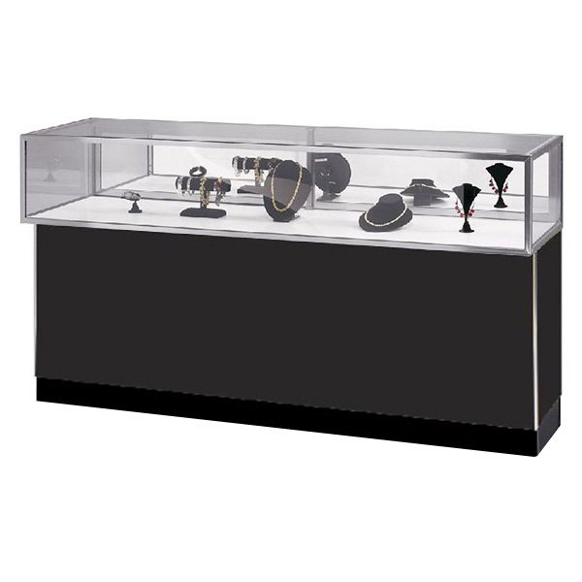
NOW WHAT?
Plunger Lock
Once the basic questions have been answered (most of them anyway), it is time to get specific.
The best way to do that is by example but understand that there is no “ one size fits all.”
Each project or program requires evaluation and consideration.
FACTS
6’ Jewelry Showcase
Stainless Steel Frame
Sliding Mirrored Doors (2)
Case Pad
Laminate Casework
Black Kick Base
(6) Storage Pull Out Drawers (Rear)
LEARN
Drawer Locks
Locks required-
Plunger Lock
(6) Drawer Locks
We selected the lock types by “application”; drawers and sliding doors.
O.K.- now that we have decided that we need these two lock types, are we finished? NO! Not so fast, go to the next step.

Slide 4
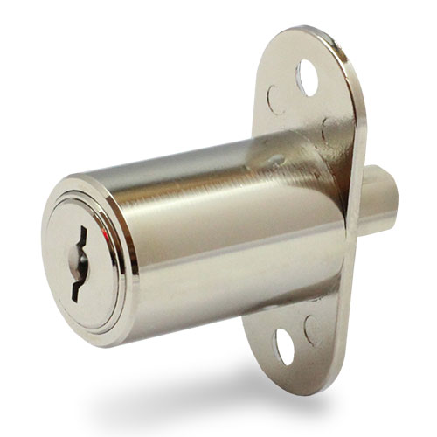
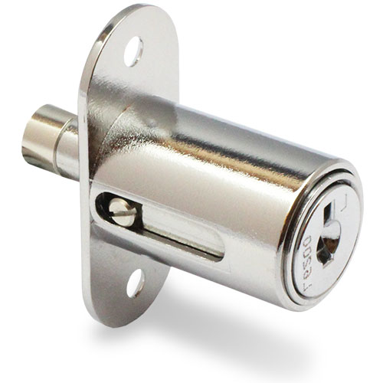
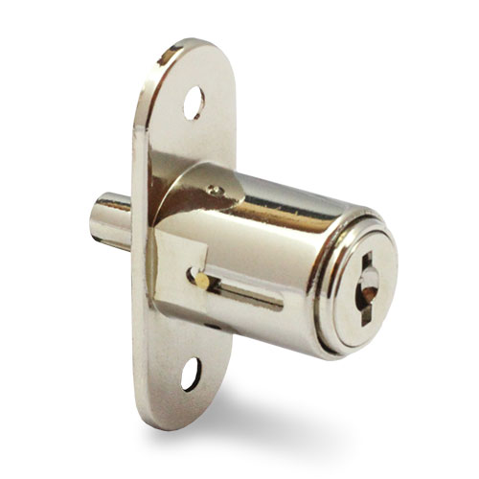
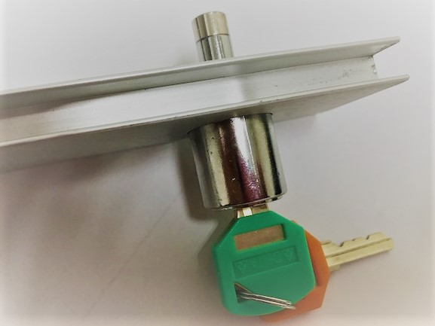
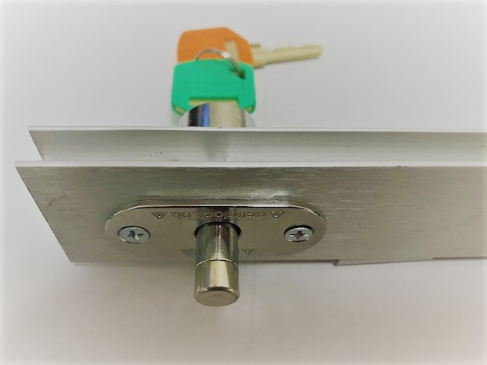
NEXT STEPS
FACTS
Sliding doors have “Rails” that guide them in a track so the doors are captured and move smoothly along the track.
Whoa! Not all Plunger locks are created equal!
The Plunger locks shown below are called Through Frame Plunger Locks.
IC Plunger Locks Restricted Key Locks Key Removable Core Plunger Locks Minimum Dimension Plunger Locks
Delta Lock’s IC Series standard sized plunger lock with key retaining feature. This lock is built with a direct driver system which allows for less moving parts. This gives you a positive lock and years of use. Keys and Cores sold separately.
ThePagoda Series is a Delta Lock controlled key system where cut keys are only available through our factory. Our Round bolt plunger lock comes with a 3/8″ diameter bolt and is suitable for both metal and glass applications. All locks are made to order.
Key Removable Core plunger locks are available in two keyways and two different key lengths. Bolt length (throw) is available in 3/8″, 1/2″ and 5/8″. Lock comes in both key retaining and non key retaining. Every round plunger bolt is drilled and tapped to receive steel insert screws.
Economy series plunger locks are competitively priced. Bolt length (throw) is available in 3/8″. Plunger lock was designed to be mounted through wood or metal. Available in non key retaining.
FRONT VIEW PLUNGER AND RAIL REAR VIEW PLUNGER AND RAIL
LEARN
The correct Plunger type must be selected that fits the Rail AND key and core format chosen.
WOW! All this just to select a Plunger lock! Drawer locks have got to be easier. Let’s see.

Slide 5
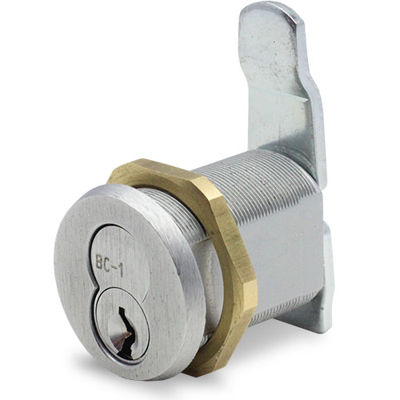
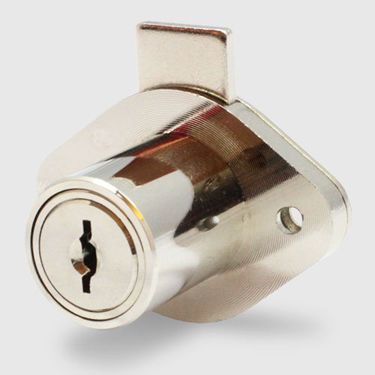
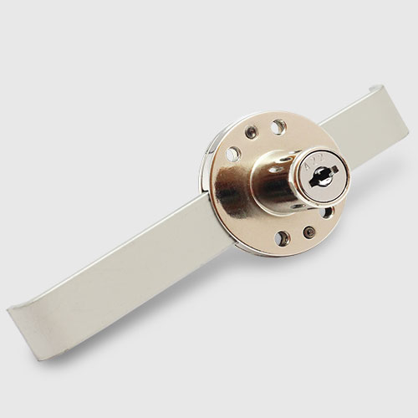
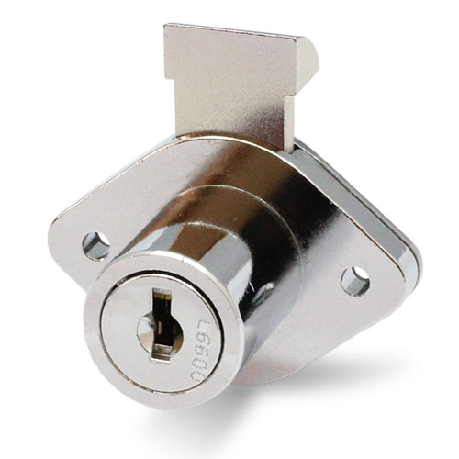
THIS IS MORE LIKE IT!
There can’t be that many kinds of Drawer Locks- am I right? NO, wrong again!
These Drawer Lock types come in the same formats as the
Plunger locks- restricted keys, removable cores, etc.
HAD ENOUGH?
CONVINCED THAT LOCKS ARE NOT FOR DUMMIES!
Cam Locks Dead Bolts Latch Bolts Gang Locks
Our IC-Series camlock is designed to fit all standard small format interchangeable cores (SFIC). It can be installed in wood, metal or glass doors and drawers. We have many cam configurations available. All cams are designed for 90° direction of turn. Keys and Cores sold separately.
The Pagoda series is a Delta Lock controlled key system where cut keys are only available through our factory. Deadbolt drawer lock is available in 15/16″ barrel length standard with three different bolt sizes. Can be used in wood or metal applications. All locks are made to order.
Key Removable Core latchbolts are available in two keyways and two different key lengths. Latchbolts are available in 1″ and 1-1/2″ barrel length dimensions. Latchbolts are uses on wood or metal applications. Optional accessories available.
Economy series gang locks are competitively priced. Comes with a .875″ barrel length. Gang locks allow just one turn of the key to lock or unlock multiple drawers at once. Available in non key retaining.
BUT WAIT-SEE THE SIMPLE ANSWER TO LOCK SELECTION ON THE NEXT PAGE!

Slide 6
O.K., I FINALLY GOT YOUR POINT!
FACT
A lock is something everyone needs and uses, is rarely specified, hardly understands and is most often taken for granted.
LEARN
As a key hardware component that offers security and asset protection, one cannot leave it to a cabinet maker to make the correct choice
for lock selection. Considering the cost of a lock is a tiny percentage of the cost of the enclosure it is used on or of the assets it protects, it is best to consult with the lock experts when selecting a lock.
TAKEAWAY
Delta Lock is the most progressive lock company in the industry offering both mechanical and electronic locks, CCTV interface with advanced analytics for BOTH mechanical and electronic locks and lock features not found anywhere else. With over 100 years of locking systems expertise, unsurpassed product quality, outstanding customer service and product support and the most stringent quality assurance standards, making your lock selection is simple- just call.
P.S. For the bashful- go to our website for instructional videos, we won’t tell anyone! www.deltalock.biz and select resources/videos.
DELTA LOCK
366 Central Ave, Bohemia NY 11716
(631) 238 – 7035
(631) 589 – 0035 Fax
customerservice@deltalock.biz

Slide 7
GLOSSARY OF LOCK LINGO
Cam Lock. A complete locking system in the form of a cylinder where the cam is the locking bolt.
Code. A designation assigned to a particular key combination for reference when additional keys or
cylinders may be needed.
Code Key. A key cut to a specific code rather than duplicated from a pattern key. it may or may not conform to the
lock manufacturer's specifications.
Control Key. Also called Pull Key, this is a key that is required for the removal and installation of lock cores. It does not lock or unlock your lock.
Core or Plug. Part of a lock cylinder into which the key enters and turns.
Deadbolt. The square-ended bolt of a lock which is moved in both locking and unlocking directions.
Electronic Lock. Lock mechanism operated by an RFID card or fob instead of a physical key.
Gang Lock. A locking mechanism with multiple bolts which locks different openings simultaneously by a single action.
Key Control. Any method or procedure which limits unauthorized acquisition of a key and/or controls
distribution of authorized keys using a systematic organization of keys and key records
Latch Bolt. A spring actuated bolt, normally with one or more beveled surfaces, which, when aligned with the strike, engages it automatically.
Lock Housing. Also called lock cylinder; that part of a locking device which is designed to hold a core.
Master Key. A key that will open every lock in a Master Key System even though each lock has its own key.
Plunger Lock. Any of various spring-loaded locks or cylinders which move in or out to accomplish a locking function.
Ratchet Lock. Any lock which incorporates a ratchet device allowing locking in more than one position.
Restricted Key. A restricted keyway lock is designed to prevent unauthorized duplication of keys. Most of these locks utilize a key that is controlled by a single source and also requires user to be on a signature card in order to have keys copied.
SFIC lock (Small Format Interchangeable Core Lock). Core can be removed from housing and swapped out.
Strike. A bolt receptacle that can be mounted on any surface as the application requires.

