Slide 1
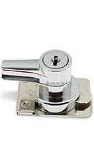
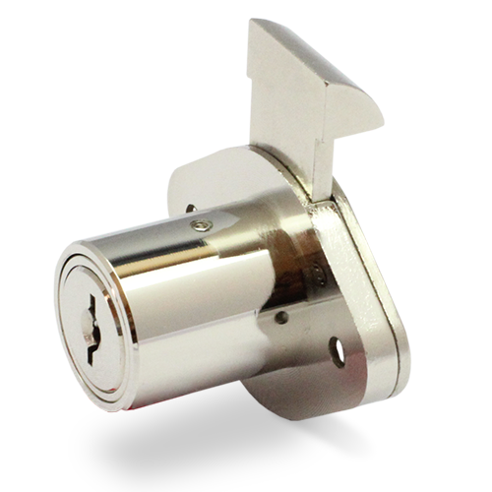
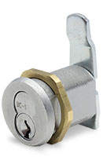
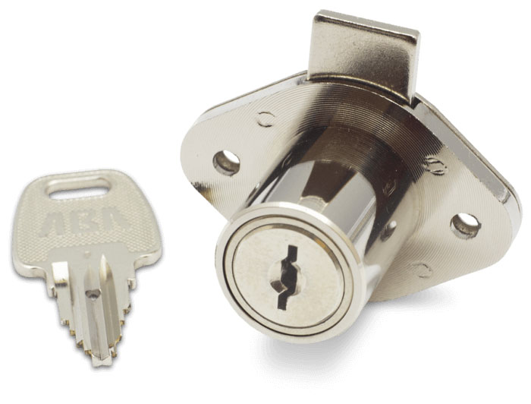
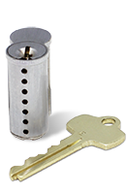
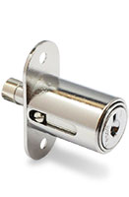
A Guide To Lock Selection

Slide 2
How To Select A Lock
Answer the questions below to find out if you are ready to select and purchase the correct lock for your project.
Circle the answers that best match your situation.
RESULTS
9 or less. Wait! Locks are the least expensive part of a fixture or display but are the most important component related to product security. Knowledge is needed regarding the nature of the asset being placed in the fixture and subsequently the type of lock selected.
Call Delta Lock for guidance.
10-13 You are on the fence! Ever give thought to lock longevity, quality durability and resistance to vandalism or thievery?
Call Delta Lock for assistance.
14-15 Go! You are ready to purchase but there are other important considerations you need to understand to ensure you are making the correct selection for the application and protection of the asset.
Call Delta Lock for their expertise and recommendations.
How many years have you been selecting lock hardware?
1. Three years or less
2. Three to five years
3. Five years or more
How much money do you allocate for a lock purchase?
1. Leave it up to the enclosure manufacturer to include
2. As little as possible
3. Shop for best price of lock type if specified
How much thought is given to lock selection?
1. Whatever engineering puts on the BOM
2. Depends upon the availability
3. Depends upon the application
How would you rate your knowledge about locks?
1. Fair
2. Pretty good
3. Good and know “all” the lock manufacturers
Would you be able to justify your selection if questioned?
1. Probably
2. More than likely
3. Definitely

Slide 3
Why Choose Delta Lock?
10
15
14
9
5
4
2
1
7
6
8
11
13
3
12
1
2
3
4
5
6789
10
11
12
13
14 15

Slide 4
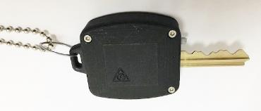
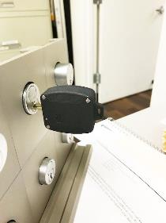
Mobi
TM
TM
Mobi is a patented retrofit smart key that uses your current key and lock to provide audit trails and activate analog or digital cameras to capture events in real time.
Lock I.D., time, date are captured when the lock is opened. Screen pops, e-mail and text messages are immediately sent to Loss Prevention and the event recorded on video.
Mobi is modular and its related components can be relocated easily to sensitive areas subject to theft.
See Mobi in action using this link.
https://www.youtube.com/watch?v=Ggd0tk7iCOk
Mobi contains artificial intelligence or AI that brings Loss Prevention analytics to a new level.
TM
TM
TM

Slide 5
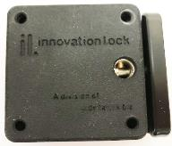
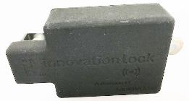
SAL 1.1 and Xero
SAL 1.1
TM
TM
TM
TM
TM
SAL 1.1 and Xero are patented RFID electronic locks containing artificial intelligence or AI.
SAL 1.1 is an invisible lock that can be mounted anywhere in a cabinet or drawer and can open/close single or multiple locks simultaneously, activate analog or digital cameras and provide audit trails for Loss Prevention data analytics.
Xero is a ratchet lock that is also RFID operated; no key to lose or replace. Card, badge or fob activated with encrypted software for added protection.
TM
Xero
TM
TM

Slide 6
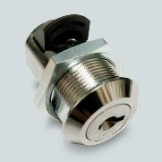
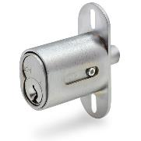
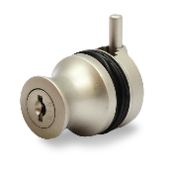
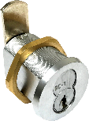
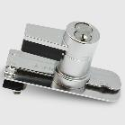
Mechanical Locks
Mechanical locks for every application. Removable core locks, SFIC, and KRC-US Series, restricted key locks, Pagoda and KRC-US Series, glass locks, mini drawer and mini plunger locks, ratchet locks, exit door locks, high security locks and padlocks.
Delta Lock can design custom locks for specific applications, pin tumbler and wafer locks.
Let Delta assist you in proper lock selection for your applifation.

Slide 7
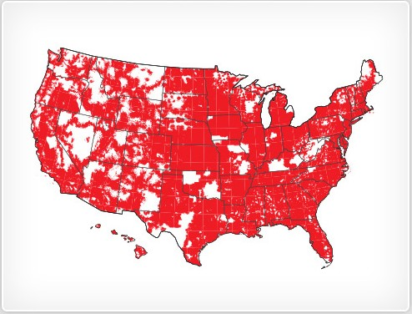
Locksmith and Installation Services
Delta Lock offers installation , repair and emergency services nationwide.
Our customers are our first priority- let Delta show you what we can do.

Slide 8
Call Delta Lock Today and reap the benefits of working with a best in class company.
Delta does not make promises it can’t keep. Experience the Delta Difference
Delta Lock Company, LLC
366 Central Avenue
Bohemia, NY 11716
(631) 238-7035 Ph. (631) 589-0035 Fax
Toll Free (855) 80 DELTA
www.deltalock.biz

