Slide 1
The Key to asset security fits a delta lock!
A Brand To Remember

Slide 2
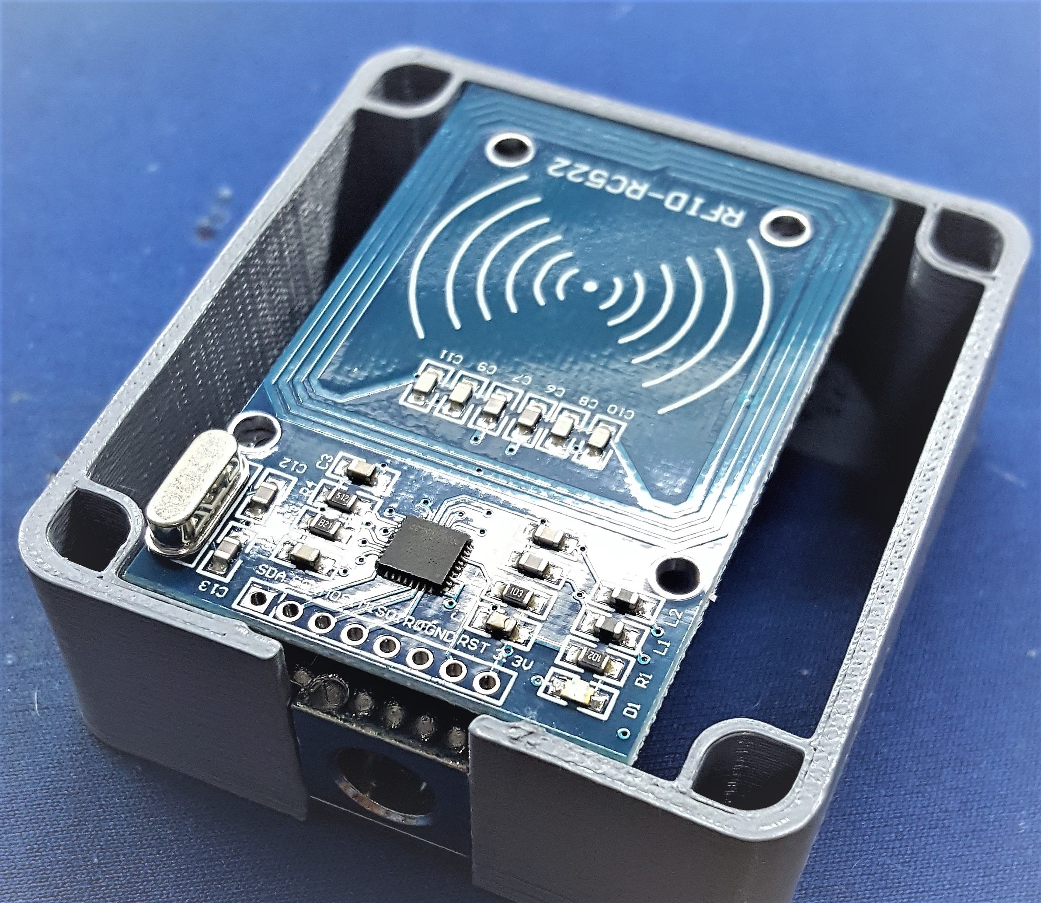
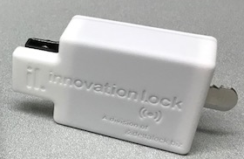
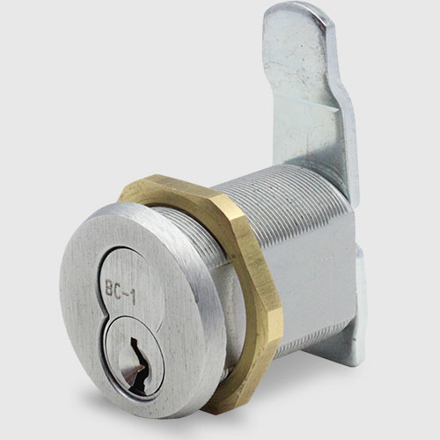
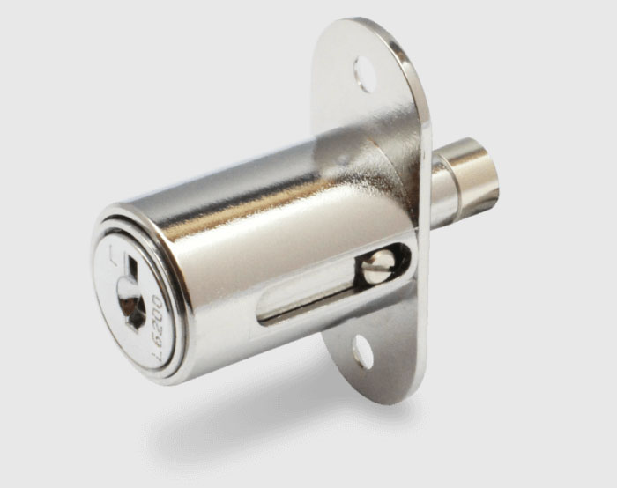
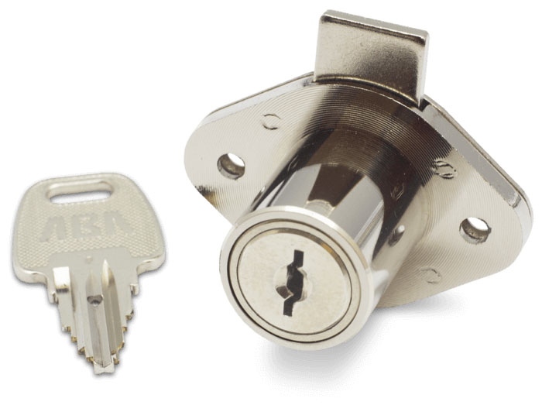
What is the least expensive part of a fixture, infrequently specified, rarely understood, most often incorrectly installed, expected to last indefinitely and required to protect virtually any asset? The answer- a lock!
Reasons Why People Don’t Think About Locks
The manufacturer will pick them
Any kind that fits the budget is o.k.
As long as they last for the warranty period
They just need to open and close
SAL1.1
Reasons Why People Should Think About Locks
Manufacturers use what they have in stock
Lock security level should match the asset’s value
Lock longevity relates to materials used to build it
Locks can have restricted keys and other options
Locks can have changeable cores
Locks can be custom designed and engineered
Locks can be mechanical or electronic
Incorrectly installed locks can cause problems
A smart key can trigger analog or digital cameras
Mechanical keys can be retrofit to be “smart”
Key management is critical in large deployments
Customer Service addresses field lock issues
Locksmith services address emergency scenarios
Import or Domestic- it makes a difference
MobiTM
Xero
SFIC
KRC-US
PAGODA
If you are convinced now that you should think about a lock, which one would you choose? Not certain- keep reading. Want instant answers, call Delta Lock
(855) 80-DELTA

Slide 3
RATING
Brand Loyalty Goes Just So Far- The Brand Paradox
The amount of trust retailers put in brands is decreasing all the time, and a typical retailer will now switch brands without hesitation if they get a better offer. Aside from a few odd exceptions, top brands are no longer able to retain their status as market leaders for very long periods. A once loyal customer base can easily disappear within twelve months. Many retailers are willing to attach themselves to certain brands as long as they have a mental attachment based upon perceived value. Research has revealed that retailers are prepared to commit to a brand as longs as they believe the brand adds value to their business. Brand paradox exists in the world today where retailers will wholeheartedly buy into specific brands, while putting less trust in brands in general at the same time.
HOW DELTA LOCK AND INNOVATION LOCK ARE OVERTAKING THE COMPETITION
Our competitors are failing to keep up with consumer expectations:. Customers don’t care that the service they are receiving is better than it was a year ago – they use other
‘best-in-class’ companies as a benchmark.
4. Delta understands our competitor’s customers. We offer them products and services that add value to their current business such as Mobi- the retrofit smart key that brings artificial intelligence to an existing lock and key.
5. It all comes down to this simple formula. Delta Lock and Innovation Lock can offer customers what our rivals currently don’t. Or can’t!
6. In our rapidly changing world, staying ahead of the curve is what matters; provide customers with what they want and need, not just what you make and hope they purchase them. This is the DELTA DIFFERENCE.
Their particular products or services did not stand out from the competition because too little thought has been put into what role their brand should play in meeting customer expectations.
With ever-increasing transparency, nearly every industry is turning into a commodity industry, which consequently results in a strong focus on price, while ignoring quality, application and innovation.

Slide 4
OUR STRATEGY
It’s Called Hardball
We pick our shots, seek out competitive encounters, set the pace of innovation, test the edges of the possible. We play to win.
We question and re-evaluate ourselves every day
We find new ways to gain knowledge-talking to customers, visiting stores, listening
We change business strategies by understanding the marketplace and budgets
We are always honest with our customers- no exaggerations or untruths
We show we understand our customers’ business and make better products to suit their needs
Our global partnerships speak to our credibility
We are creative and innovative- never standing still or being complacent
We offer the best customer service- paying attention to customer pain points, being proactive not just reactive
We are great communicators- no company is great at everything, but we are great at what we do
Competition makes us work smarter- often times harder too.

Slide 5
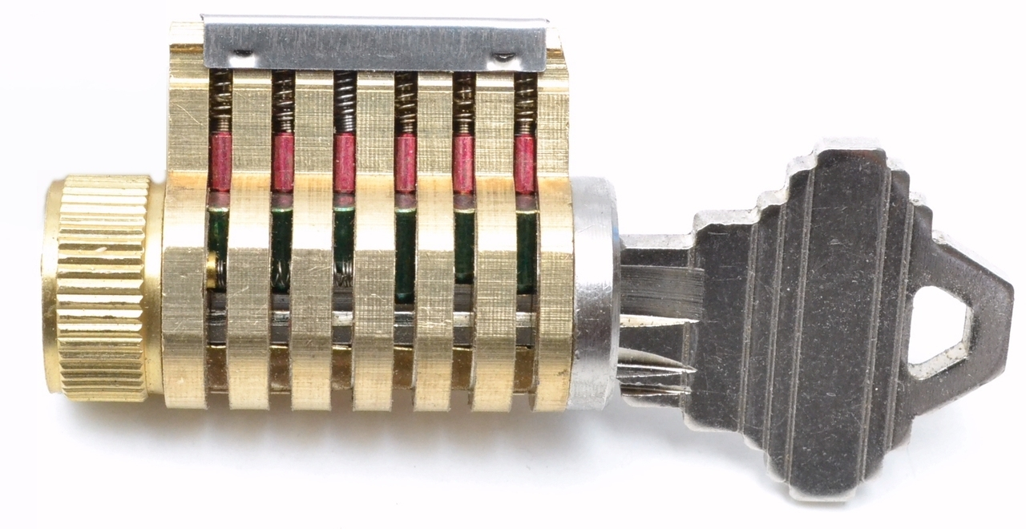
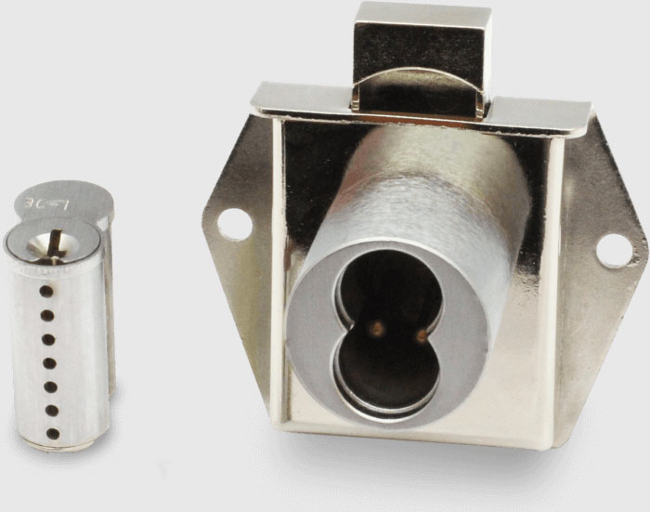
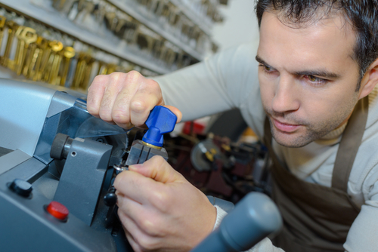
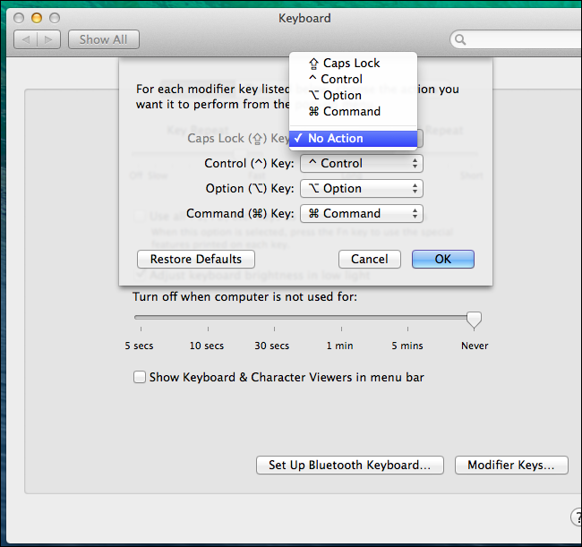
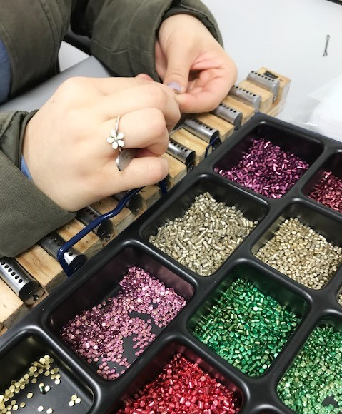
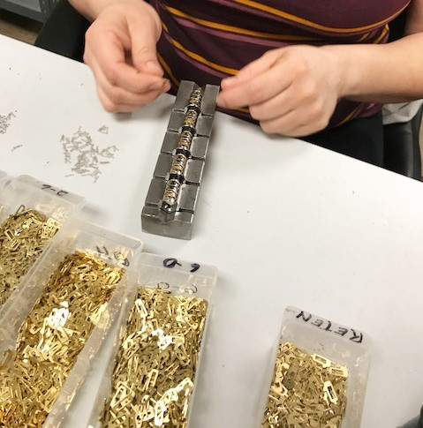
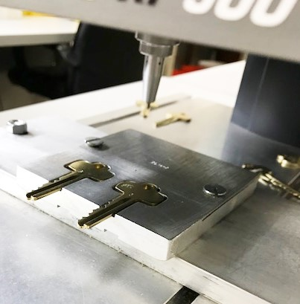
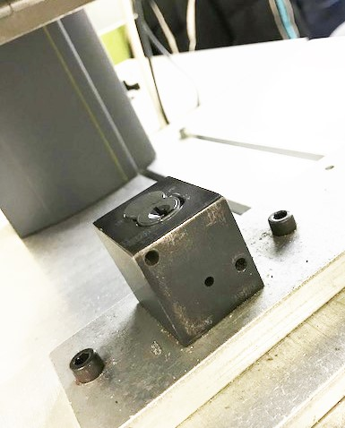
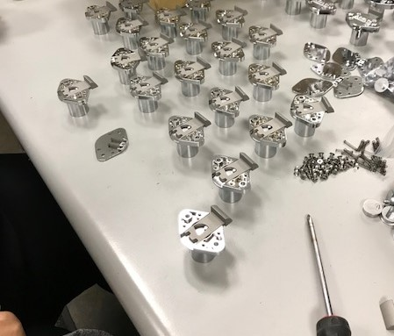
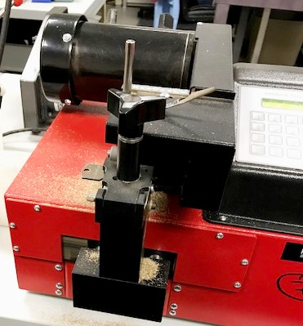
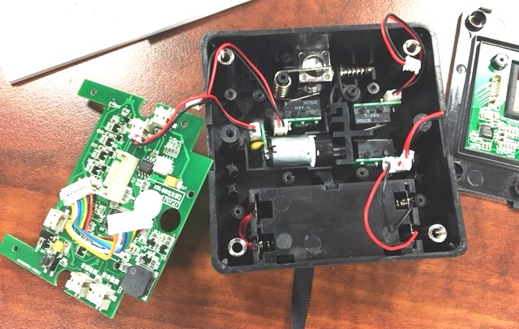
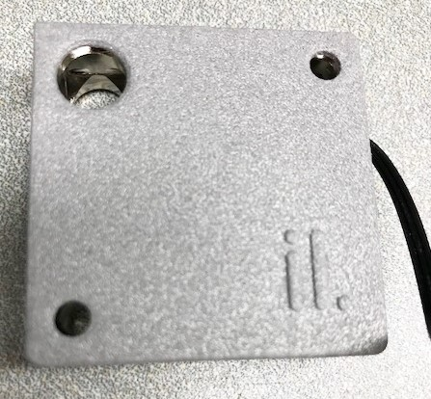
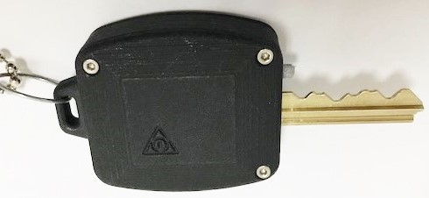
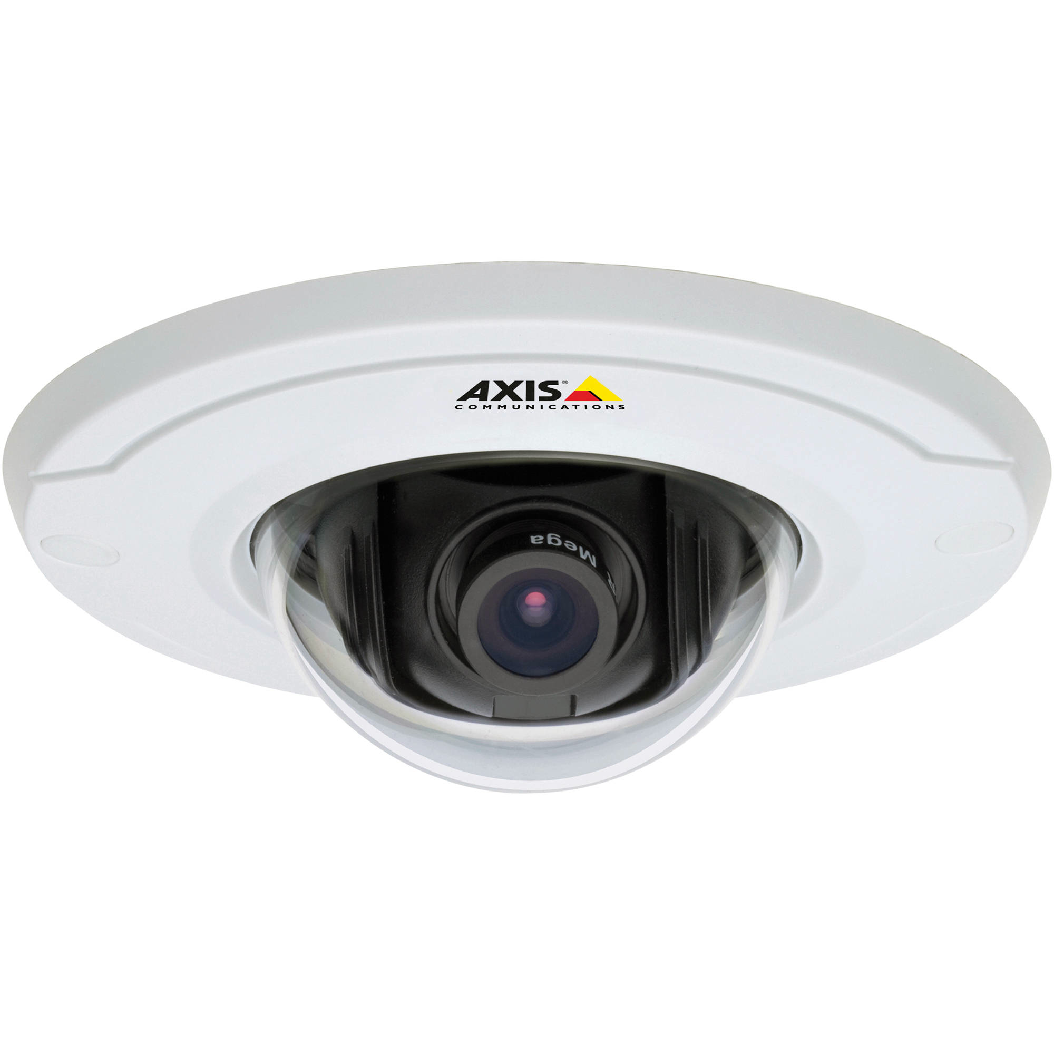
OUR CORE COMPETENCIES AND VALUE PROPOSITIONS
Delta Lock is the largest dcustom lock manufacturer in the U.S.
Some of the stages in our lock and key fabrication- Core Assembly, Spring and Pin Insertion, Latch Assembly, Core Boring, Core Testing, Key Stamping, Key Cutting, Key Engraving.
Our technology division, Innovation Lock, designs, engineers and manufactures electronic locks, retrofit “smart keys”, digital/analog camera interfaces and other asset security devices for multiple venues.

Slide 6
WHY DELTA LOCK IS BEST IN CLASS
OUR TURNKEY PROCESS
Talent. There is simply no substitute for talent and we have it in every department.
Passion. Passion drives greatness. Passion is contagious. A passionate employee will go the extra mile – and then some; and we cultivate it.
Attitude. There is nothing as refreshing and uplifting as someone with an upbeat, kind, generous personality; we nurture it.
Aptitude. For our jobs, skills are the bottom line and our employees have them.
Fortitude. A great company and great leadership never rests. It is never quite satisfied. Delta Lock is always looking to better not only the competition, but itself.

Slide 7
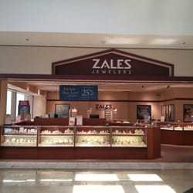
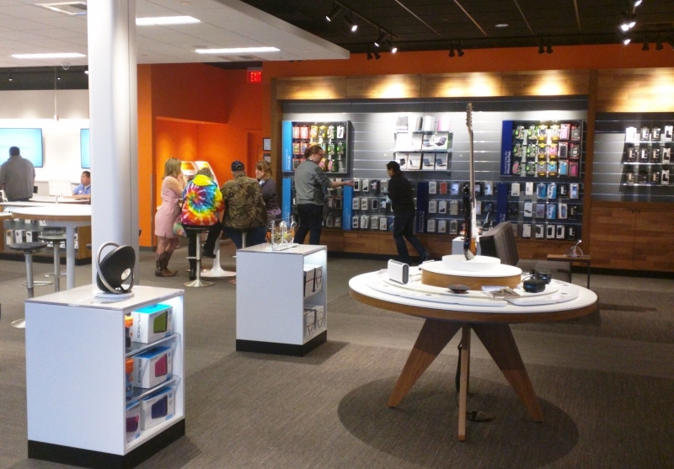
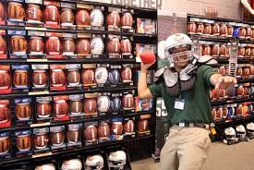
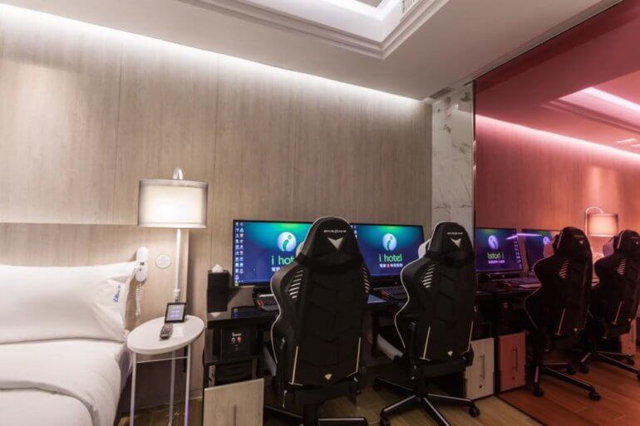
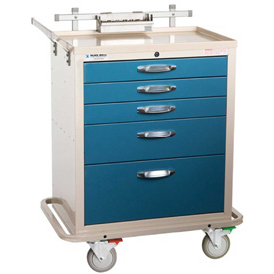
THE BALL IS IN YOUR COURT
Let Delta Lock show you what we can do; we’re simply the best- better than all the rest.
RETAIL JEWELRY RETAIL WIRELESS/ELECTRONICS SPORTS & ENTERTAINMENT HOSPITALITY & GAMING HEALTHCARE
CALL TODAY! TOLL FREE (855) 80-DELTA
Delta Lock Company, LLC
366 Central Avenue
Bohemia, NY 11716
(631) 238-7035 Phone
(631) 589-0035 Fax
www.deltalock.biz

